Slide 1

Edit Distance

Slide 2
Introduction
Given two strings str1 and str2 of length M and N respectively and below operations that can be performed on str1. Find the minimum number of edits (operations) to convert ‘str1‘ into ‘str2‘.
Operation 1 (INSERT): Insert any character before or after any index of str1
Operation 2 (REMOVE): Remove a character of str1
Operation 3 (Replace): Replace a character at any index of str1 with some other character.
Example1 : Input: X[]=“cat” Y[] = “cut” Output=1
Example2 : Input: X[]=“horse” Y[] = “ros” Output=3, Explanation: replace ‘h’ with ‘r’ resulting ‘rorse’, then removing ‘r’ and ‘e’ resulting into ‘ros’
Example1 : Input: X[]=“sunday” Y[] = “saturday” Output=3
Example1 : Input: X[]=“intention” Y[] = “execution” Output=5

Slide 3
Solution Approaches
Brute force recursive approach
Dynamic Programming

Slide 4
Brute force approach
The idea is to process all characters one by one starting from either from left or right sides of both strings.
Process from the right end of the strings, there are two possibilities for every pair of characters being traversed, either they match or they don’t match.
If last characters of both string matches then there is no need to perform any operation So, recursively calculate the answer for rest of part of the strings.
When last characters do not match, we can perform all three operations to match the last characters in the given strings, i.e. insert, replace, and remove.
We then recursively calculate the result for the remaining part of the string. Upon completion of these operations, we will select the minimum answer.

Slide 5
EditDistance(X,Y,m,n)
Case-1: if (X[m-1]==Y[n-1]) then do not perform any operation. Ignore the last character and perform the same operation recursively for the remaining string of size (X,Y,m-1,n-1)
Case-2: if(X[m-1]!=Y[n-1]) then consider all three operation (insert delete or replace) to make the last character of first string to be equal to the last character of the second string
Insert str1[N-1] at last of str2 : EditDistance(M, N-1)
Replace str2[M-1] with str1[N-1] : EditDistance(M-1, N-1)
Remove str2[M-1] : EditDistance(M-1, N)

Slide 6
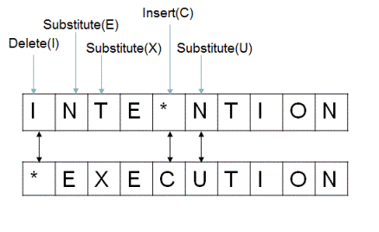
Recurrence Relation for edit distance
editDistance(X,Y,m,n)
if(m==0)
return m
if(n==0) base case
return n
if(X[m-1]==Y[n-1])
return editDistance(X,Y,m-1,n-1)
else
{
return 1+min({editDistance(X,Y,m,n-1),editDistance(X,Y,m-1,n), editDistance(X,Y, m-1,n-1)}
}

Slide 7
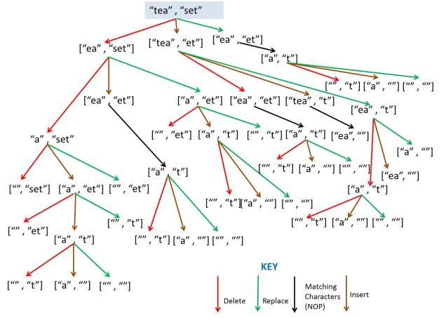

Slide 8
Example
To convert BIRD to HEARD, I would need to make 3 changes, those being:
Replacing ‘I’ of BIRD with ‘A’. Thus, BIRD now changes to BARD.
Replacing ‘B’ of BIRD with ‘E’. Hence, it further changes to EARD.
Adding H at the beginning. Finally, we get HEARD.

Slide 9
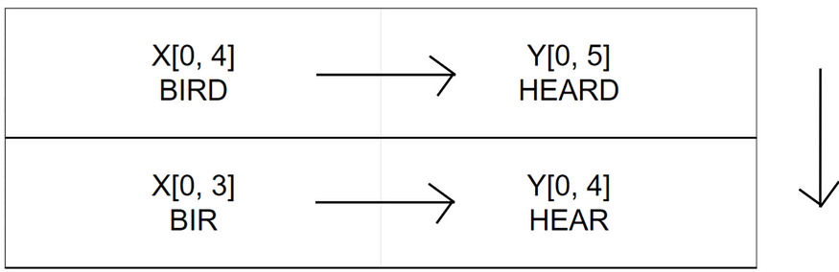
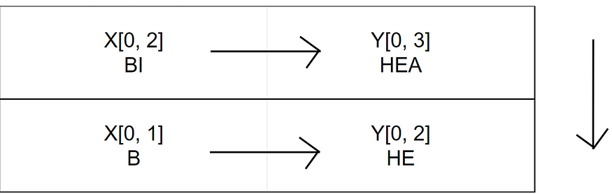
Example
Do nothing
Replace: To convert ‘BI’ to ‘HEA’, then notice that the last characters of those strings are different. Hence to convert ‘BI’ to ‘HEA’, we just need to convert ‘B’ to ‘HE’ and simply replace the ‘I’ in ‘BI’ to ‘A’. This way we have changed the string to ‘BA’ instead of ‘BI’. So now, we just need to calculate the distance between the strings minus the last character. Hence our edit distance of ‘BI’ and ‘HEA’ is 1 + edit distance of ‘B’ and ‘HE’.

Slide 10
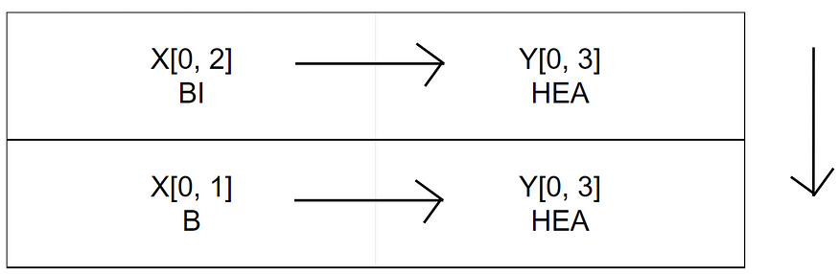
Example
Deletion: Deletion can also be considered for cases where the last character is a mismatch. In this example; if we want to convert ‘BI’ to ‘HEA’, we can simply drop the ‘I’ from ‘BI’ and then find the edit distance between the rest of the strings. Remember, if the last character is a mismatch simply delete the last character and find edit distance of the rest.

Slide 11
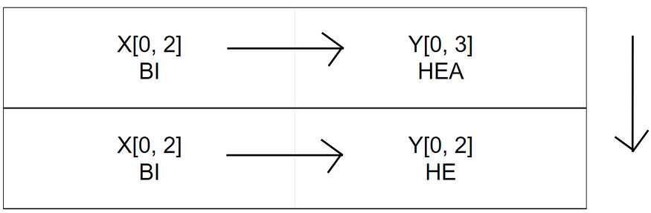
Example
Insertion: Another way to resolve a mismatched character is to drop the mismatched character from the source string and find edit distance for the rest. In this example; we wish to convert ‘BI’ to ‘HEA’, notice the last character is a mismatch. One possible solution is to drop ‘A’ from ‘HEA’. This way we’ll end up with ‘BI’ and ‘HE’, after finding the distance between these substrings, because if we find the distance successfully, we’ll just have to simply insert an ‘A’ at the end of ‘BI’ to solve the sub problem.
Remember, if the last character is a mismatch simply ignore the last letter of the source string, find the distance between the rest and then insert the last character in the end of destination string.

Slide 12
Example
Take the minimum of these operations and add one to it because we’re performing an operation on these two characters that didn’t match.

Slide 13
Base Case
In order to convert an empty string to any string “xyz”, we essentially need to insert all the missing characters in our empty string. Hence, in order to convert an empty string to a string of length m, we need to do m insertions; hence our edit distance would become m.
Similarly in order to convert a string of length m to an empty string “” we need to perform m number of deletions; hence our edit distance becomes m.

Slide 14
Using Dynamic Programming
In Dynamic Programming algorithm we solve each sub problem just once and then save the answer in a table.
Steps
editDistance(X,Y,m,n,DP) where X and Y are strings, m and n are length of X and Y respectively and DP is two dimensional matrix that has dimension of DP[m+1][n+1] and initialize it with -1.
Base Condition : if (m==0) return n and if(n==0) then return m.
Check if edit distance of current m and n values has already been calculated and stored at DP[m,n] then return the stored value i.e. if(DP[m][n]!=-1) return DP[m][n]
If (X[m-1]==Y[n-1]) we recursively call the editDistance(X,Y,m-1,n-1,DP) to compute the edit distance without considering the last character and will store DP[m][n].

Slide 15
Algorithm
If(X[m-1]!=Y[n-1] then
editDistance(X,Y,m,n-1,DP)
editDistance(X,Y,m-1,n,DP)
editDistance(X,Y,m-1,n-1,DP)
Compute the minimum of above and add 1 because of the operation performed and store the result in DP[m][n]

Slide 16
Algorithm
editDistance(X,Y,m,n, DP)
{
if(m==0)
return n
if(n==0)
return m
if(DP[m][n]!=-1)
return DP[m][n]
if(X[m-1]==Y[n-1])
DP[][]=editDistance(X,Y,m-1,n-1,DP)
else
{
dp[][]=1+min({editDistance(X,Y,m,n-1,DP),
min(editDistance(X,Y,m-1,n,DP),
min(editDistance(X,Y,m-1,n-1,DP)})
}
return DP[m][n]

Slide 17
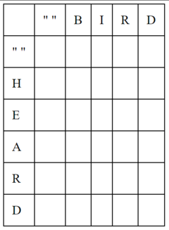
Writing all the characters in our strings. Put the string to be changed in the horizontal axis and the source string on the vertical axis.
Fill base case values.

Slide 18
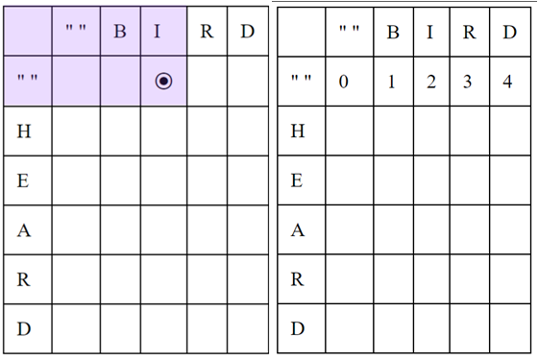
Edit distance to convert any string to an empty string is the length of the string itself. So, the edit distance to convert “B” to empty string is 1; to convert “BI” to empty string is 2 and so on.

Slide 19
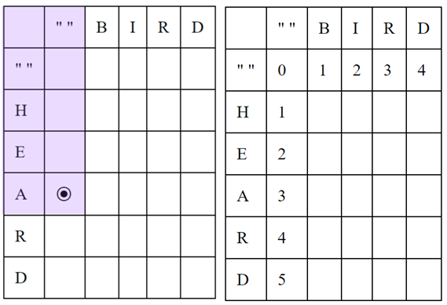
Similarly, to convert an empty string to a string of length m, we would need m insertions. Thus, to convert an empty string to “HEA” the distance is 3; to convert to “HE” the distance is 2 and so on.

Slide 20
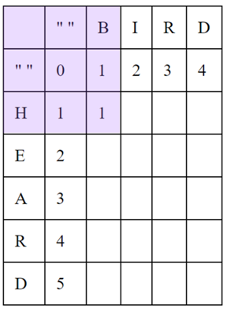
Consider the next case where we have to convert “B” to “H”. Here we will perform a simple replace operation. We want to take the minimum of these operations and add one when there is a mismatch. So, in the table, we will just take the minimum value between cells [i-1,j], [i-1, j-1] and [i, j-1] and add one. In this case, we take 0 from diagonal cell and add one i.e. we performed a replace operation.
When the two characters match, we simply take the value of the [i-1,j-1] cell and place it in the place without any incrementation.

Slide 21
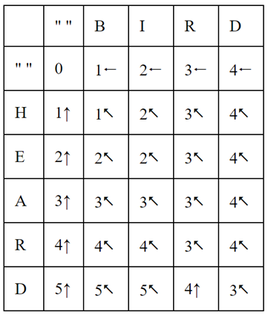
After filling up the table

Slide 22
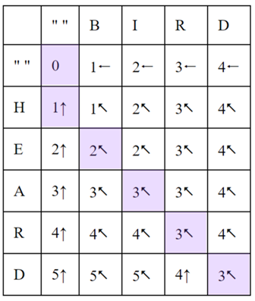
Getting the result
We start with cell [5,4] where our value is 3 with a diagonal arrow. But since the characters at those positions are the same, we don’t need to perform an operation. Hence we simply move to cell [4,3]
In cell [4,3] we also have a matching set of characters so we move to [3,2] without doing anything.
At [3,2] we have mismatched characters with a diagonal arrow indicating a replacement operation. Hence, we replace ‘I’ in ‘BIRD’ with ‘A’ and again follow the arrow.
At [2,1] we again have mismatched characters similar to point 3 so we simply replace ‘B’ with ‘E’ and move forward.
At [1,0] we have an upwards arrow meaning insertion. Hence we insert ‘H’ at the beginning of our string then we’ll finally have ‘HEARD’.

Slide 23
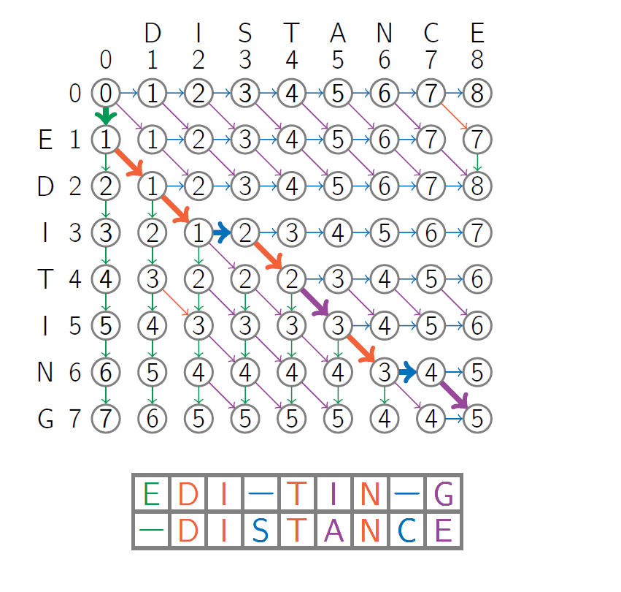
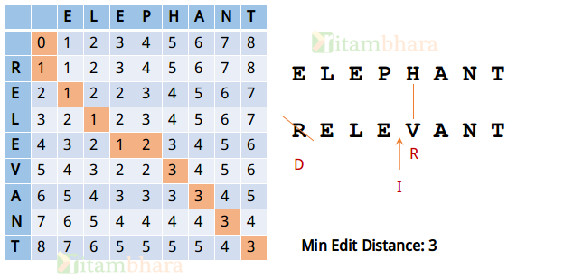

Slide 24
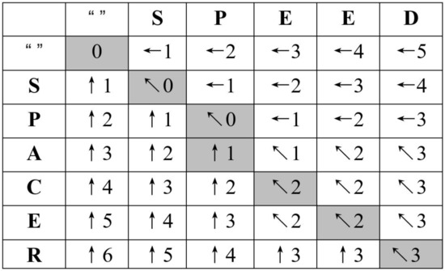

Slide 25
